Slide 1
RAJALAKSHMI ENGINEERING COLLEGE PYTHON PROGRAMMING

Slide 2
CONTENTS
Iteration Control Structure(Looping)
while
for
range function
break
continue
Nested loops
Nested If

Slide 3
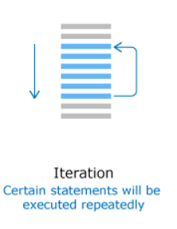
Iteration Control Structure

Slide 4
Iteration Control Structures
break statement
while loop
continue statement
for loop
pass statement

Slide 5

Iteration Control Structures
while loop
Repeats the execution of the statements within the while block when the condition is true . when the condition is false exits the while block.
Syntax

Slide 6
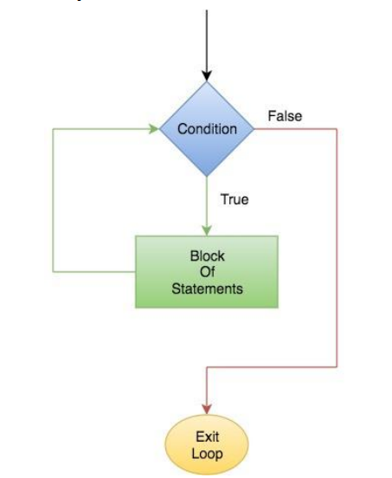
Flowchart of While Loop

Slide 7
Example
x = 0
while (x < 5):
print(x)
x = x + 1
Output :
0
1
2
3
4
x = 1
while (x <= 5):
print(“REC”)
x = x + 1
Output :
REC
REC
REC
REC
REC

Slide 8
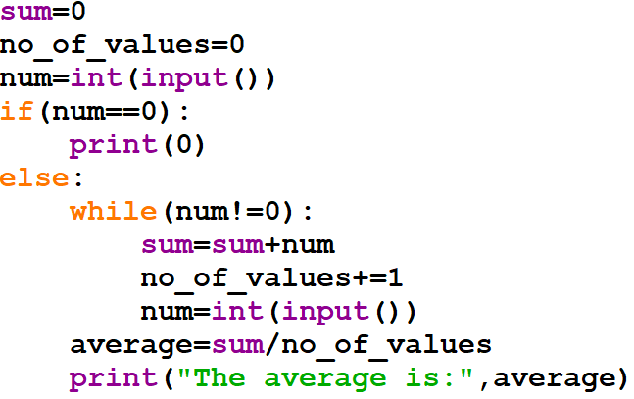
Create a program that computes the average of a collection of values entered by the user. The user will enter 0 as a sentinel value to indicate that no further values will be provided. Your program should display an appropriate error message if the first value entered by the user is 0.Hint: Because the 0 marks the end of the input it should not be included in the average.
Example
Logic:
Find Sum ,then…
Average=Sum/total no of values
Total no of values???
Find Sum and Total no of values
Finally find average
Input:
List of Numbers
Eg:1,2,3,9,8,7,
Output:
Find Average
0

Slide 9
Prog. To find digit sum
num = int(input(“No.?”))
ds = 0
while num>0 :
ds = ds +num % 10
num = num // 10
print(“Digit Sum :”, ds)
Prog. To find reverse
num = int(input(“No.?”))
rev = 0
while num>0 :
d = num % 10
rev = rev*10 + d
num = num // 10
print(“Reverse :”, rev)

Slide 10
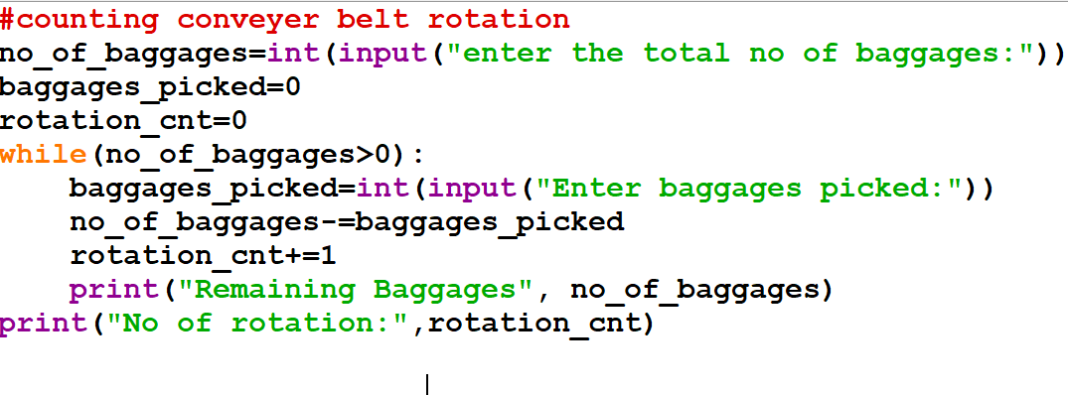
Example
Lets take an Airport Scenario,
Conveyer belt rotation for collecting baggage

Slide 11
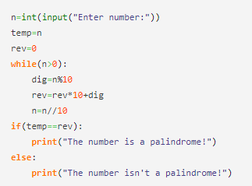
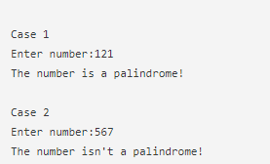
checks whether it is a palindrome or not

Slide 12
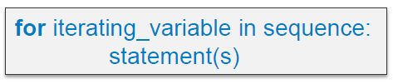
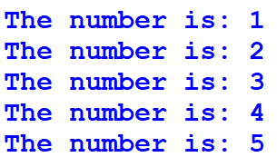

Iteration Control Structures
for loop
Syntax
Repeats the execution of set of statements for a specific number of times.

Slide 13
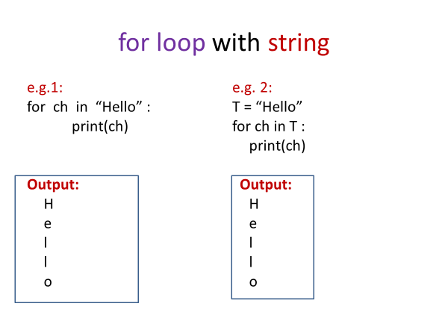
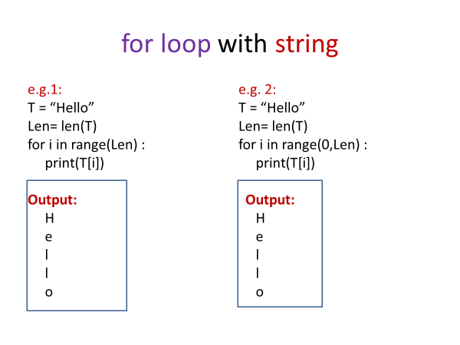

Slide 14
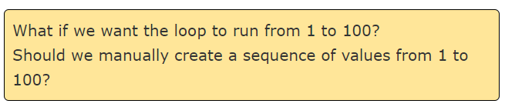

Slide 15
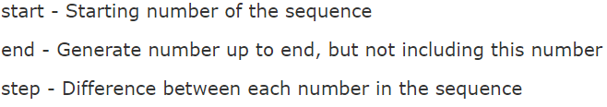
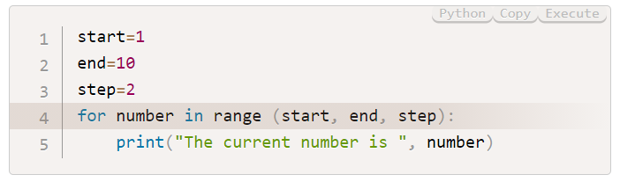
In Python, there is an easy way to achieve this by using a built-in function
range(start , end, step)

Slide 16
Example
for i in range(1,5):
print(i)
Output :
1
2
3
4
for i in [1,2,3,4] :
print(“REC”)
Output :
REC
REC
REC
REC
for i in range(5):
print(i)
Output :
0
1
2
3
4
for i in range(2,9,2):
print(i)
Output :
2
4
6
8

Slide 17
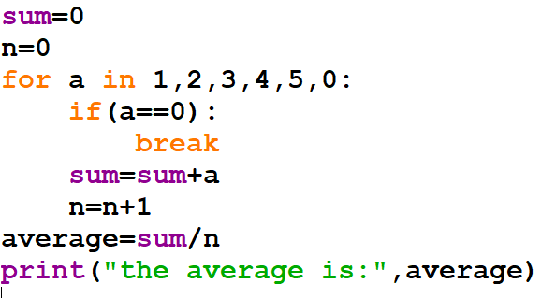
Iteration Control Structures
break
When we want to stop a loop based on an external condition, we can use break statement

Slide 18
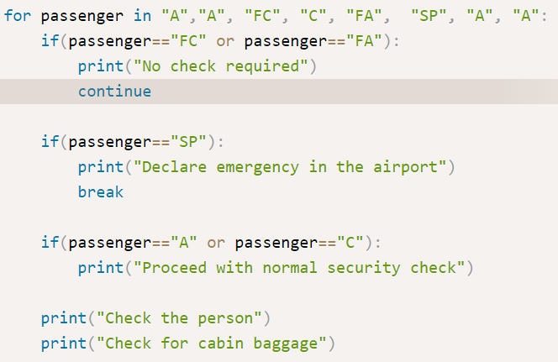
Iteration Control Structures
continue
When we want to skip the remaining portion of the loop and continue with next iteration , we can use continue statement

Slide 19
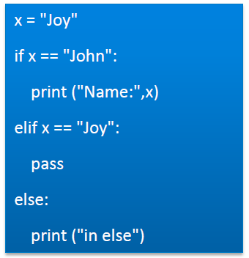
Iteration Control Structures
pass
Pass statement is never executed. Behaves like a
Placeholder for future code

Slide 20
Iteration Control Structures
Nested loops
A nested loop is a loop inside a loop.
The "inner loop" will be executed one time for each iteration of the "outer loop":

Slide 21
Example

Slide 23
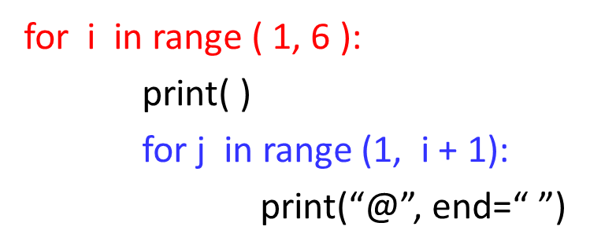
@
@@
@@@
@@@@
@@@@@

Slide 24
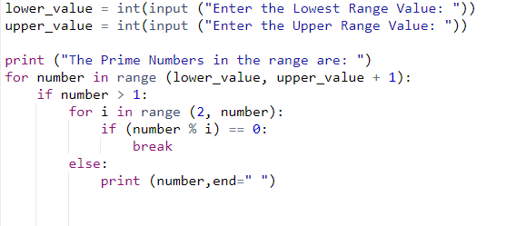

Print the Prime Number between the given Interval.

Slide 25


